Slide 1

CUSTOMER RENTENTION STUDY
Submitted by-
Sachin Gupta

Slide 2
Introduction
Customer retention refers to the ability of a company or product to retain its customers over some specified period. High customer retention means customers of the product or business tend to return to, continue to buy or in some other way not defect to another product or business, or to non-use entirely. Selling organizations generally attempt to reduce customer defection. Customer retention starts with the first contact an organization has with a customer and continues throughout the entire lifetime of a relationship and successful retention efforts take this entire lifecycle into account. A company's ability to attract and retain new customers is related not only to its product or services, but also to the way it services its existing customers, the value the customers actually perceive as a result of utilizing the solutions, and the reputation it creates within and across the marketplace.

Slide 3
Problem Statement Analysis
In e-commerce platform customer satisfaction is a important parameter for customer retention.
Success of on-line shopping depends on four major factors :
a) service quality
b) system quality
c) information quality
d) trust & benefit
From this dataset I have collected various information which gives me an idea of purchasing online products for the customers.
I have done some data analysis to provide valuable insights that helps understand the customer better.
In this Dataset I have check possible ways for customer retention.

Slide 4
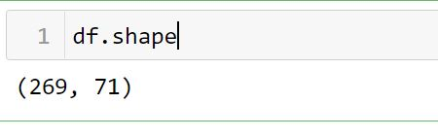
Exploratory data analysis process
Using the shape we find out the total number of rows & columns present in the dataset.

Slide 5
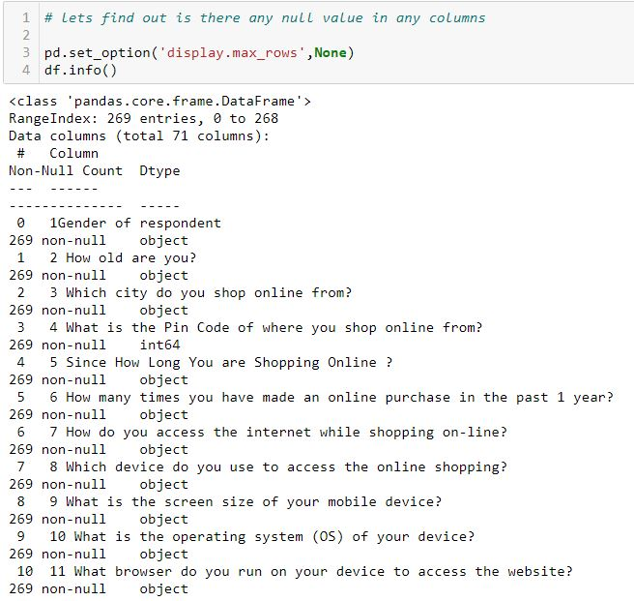
Exploratory data analysis process
By Using display I can see the name of all the columns & with info I can find out
there is no null values in the dataset.

Slide 6
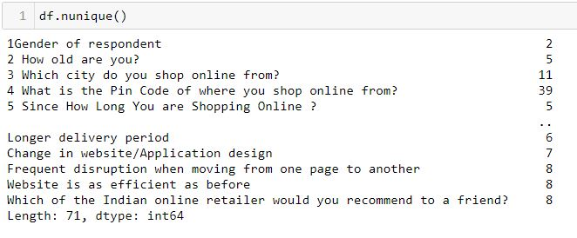
Exploratory data analysis process
With the help of nunique I can figure out the continuous & categorical column.
However most of the columns are categorical in nature.

Slide 7
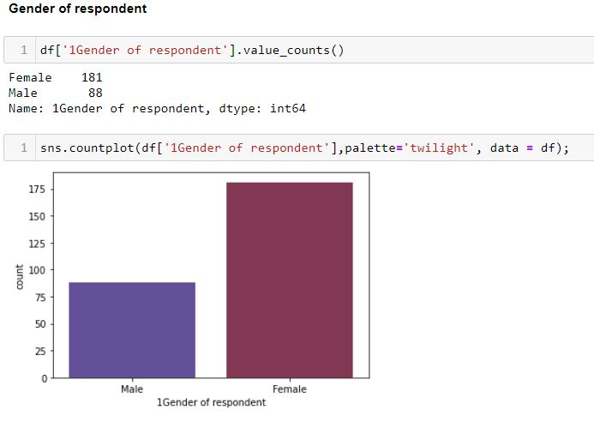
Data Visualization process
From the above count plot I can say that female prefer online shopping more
than male as the number of female for online shopping is almost twice than male.

Slide 8
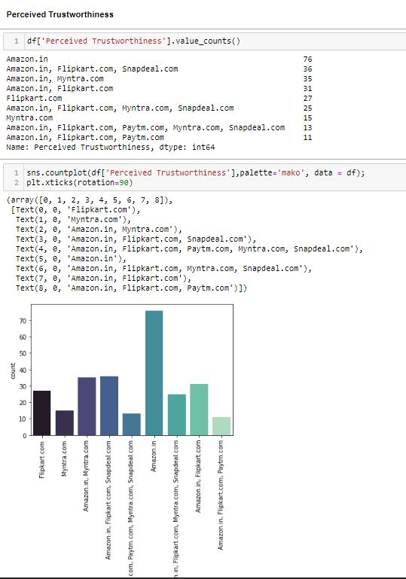
Data Visualization process
Trust plays the vital role in any brand.
The above graph I can say that amazon have huge brand value as it is trust worthy.

Slide 9
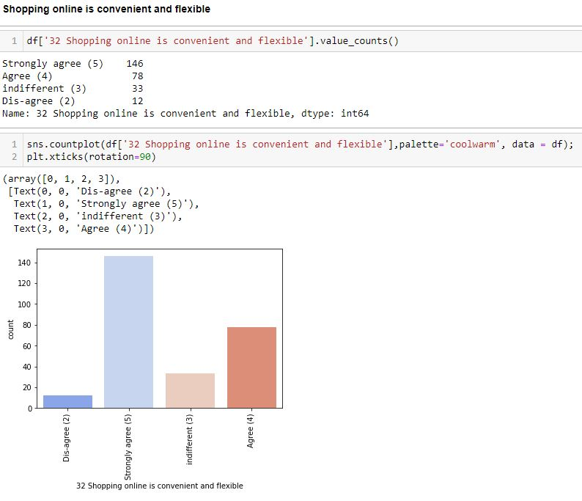
Data Visualization process
In online shopping customer are strongly agree with the fact that Shopping online is convenient and flexible.

Slide 10
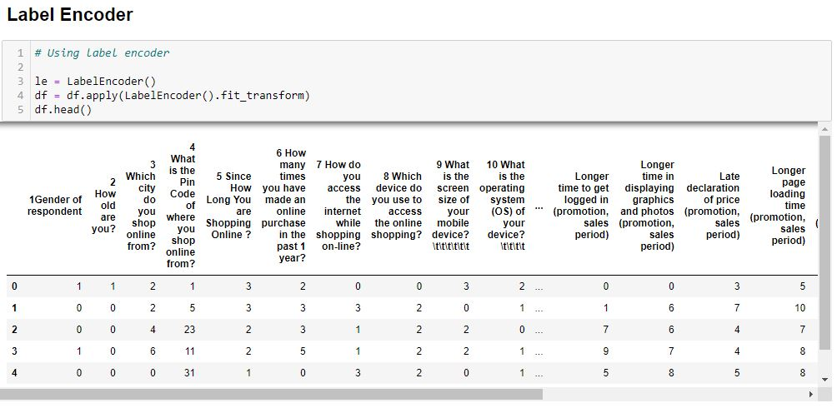
Label Encoder Process
Applied Label Encoder to convert all the string columns into integers.

Slide 11
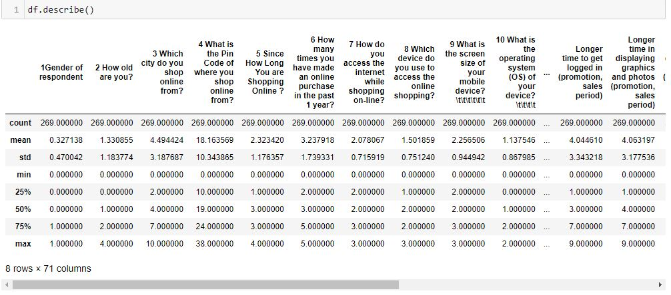
Exploratory data analysis process
From the above describe method :
I find out that how each parameters are distributed across the dataset & by using
this method I got to know the five point summary analysis like mean, max and the quartiles.

Slide 12
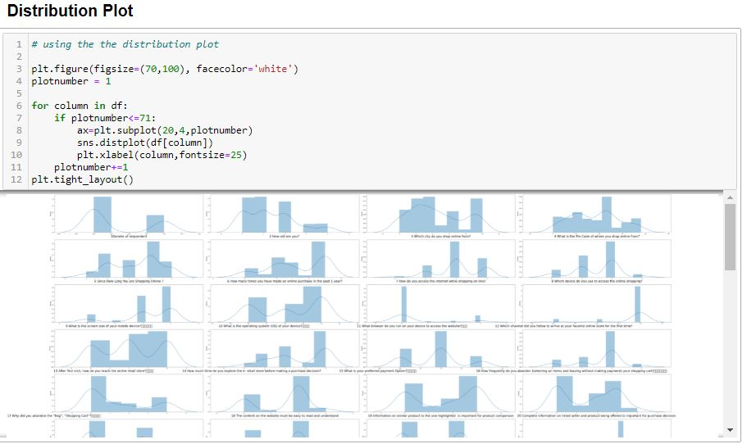
Distribution Plot
From the above Distribution Plot I can say that Most of the columns are
Categorical in nature & the dataset is normally distributed.

Slide 13
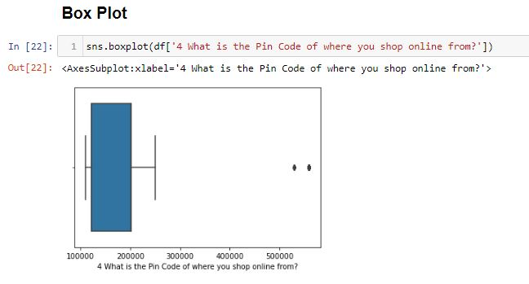
Box Plot
There is no outliers in any columns

Slide 14
Interpretation of the Results
I have used various visualization tool such as Count Plot, Box Plot & Distribution Plot to understand the data in a better way.
I have also used label encoder technique and convert all the data into numerical form to do the data analysis in an easier way.
I used describe method for five-point summary analysis and also found the number of rows and columns in dataset.
There is no missing values in the dataset and no outliers detected in the dataset.

Slide 15
CONCLUSIONS
From this dataset I can understand that online shopping have huge scope in Indian market.
This customer satisfaction can be used as an impact of e-commerce market development as well as for economic development of the country.
Companies like amazon , flipkart have satisfied there customer which not only help them to retain there customers but also add more and more customer to his business.

